Slide 1
Introduction to Computation Theory
Chapter 1 – Regular Language
(modified from slides by Prof. Amos Israeli)

Slide 2
Computational Models
A Computational Model describes an idealized computer that enables us to reason about computation and to study the properties and limitations of computing.
It is very much like a mathematical model, but simplier.

Slide 3
Computational Models
Three main models of computations:
Finite Automaton (FA). recognizes Regular Languages .
Push Down Automaton (PDA). recognizes Context Free Languages .
Turing Machines (TM). recognizes Computable Languages .

Slide 4
Finite Automaton - An Example
0
0,1
1
0,1
Set of States:
Initial State:
Accept State(s):

Slide 5
Finite Automaton – An Example
0
0,1
1
0,1
Transition Function:
Alphabet: .
Note: Each state has all transitions .
Accepted words:

Slide 6
Finite Automaton – Formal Definition
A finite automaton is a 5-tupple where:
is a finite set called the states.
is a finite set called the alphabet.
is the transition function.
is the start state, and
is the set of accept states.

Slide 7
Deterministic Nature
Each state has a single transition for each symbol in the alphabet.
Every DFA has a computation for every finite string over the alphabet.

Slide 8
Examples
accepts all words (strings) ending with 1. The language recognized by , called satisfies: .

Slide 9
How to make an FA
Find some simple examples (short accepted and rejected words)
Think what each state would “remember” and draw the states with a proper name.
Draw transitions that preserve the states’ “memory”.
Validate or make correction.

Slide 10
The (D)FA
Correctness Argument:
The FA’s states encode the last input bit and q1 is the only accepting state. The transition function preserves the states encoding.
1
1
1
0
0
0

Slide 11
Examples (HW1B) – draw FA for the following (For HW2, use FSMD by Evan Wallace)
1. M₃ accepts words ending with 0 and the empty word ε.
2. M₄ accepts strings that start and end with the same symbol.
3. M₅ accepts these 5 words: 0, 1, 00, 01, 10
4. M₆ accepts words of the form 0^{m}1^{n}, where m & n are positive integers.
5. M₇ accepts all words which contains the 110 substring

Slide 12
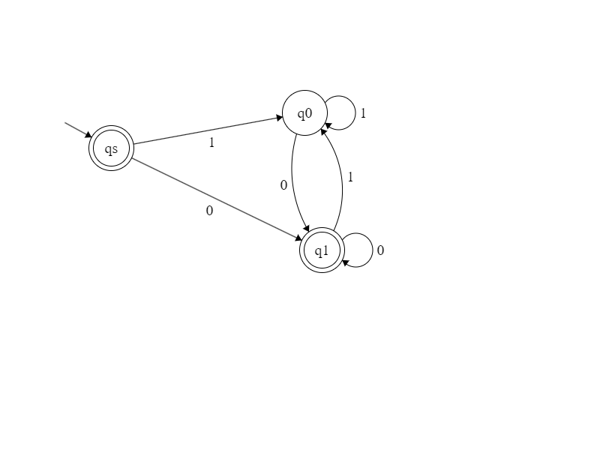
1. M₃ accepts words ending with 0 and the empty word ε.

Slide 13
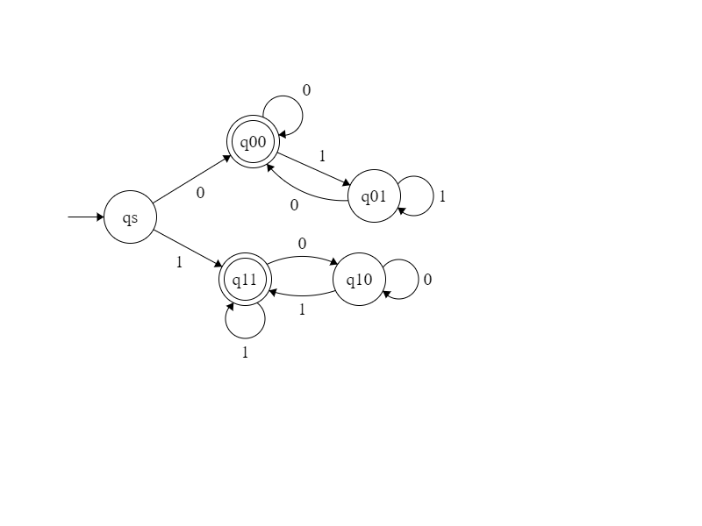
2. M₄ accepts strings that start and end with the same symbol.

Slide 14
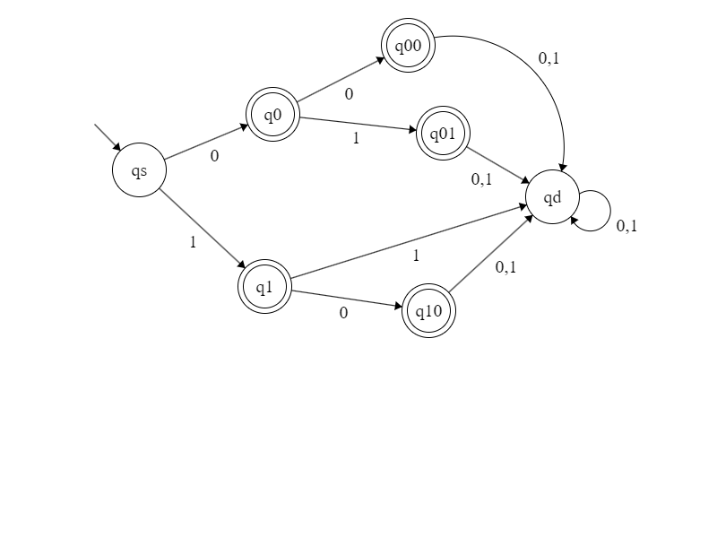
3. M₅ accepts these 5 words: 0, 1, 00, 01, 10

Slide 15
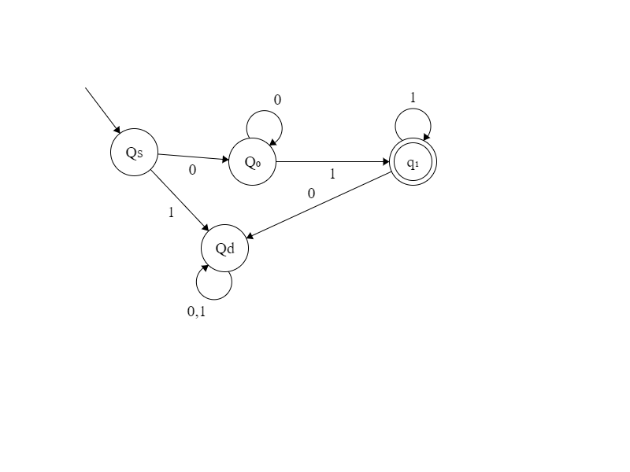
FA solution (4)

Slide 16
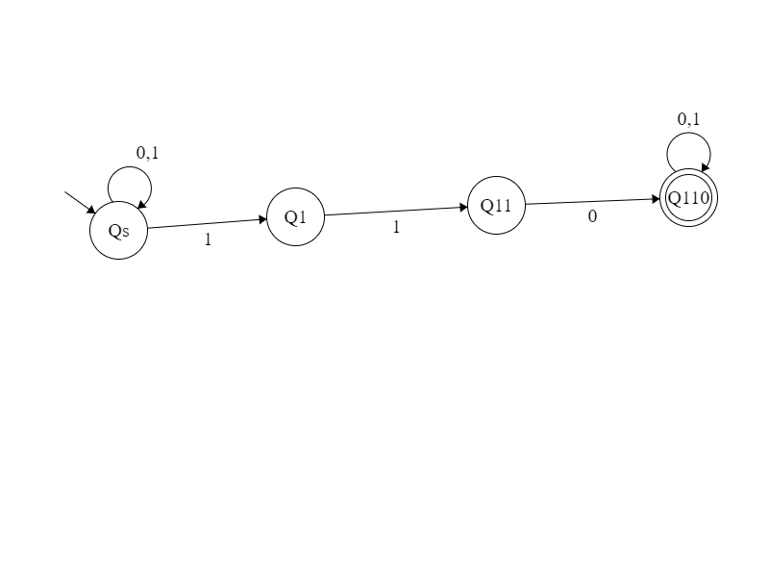
5 NFA

Slide 17
Languages in general
Definition: A language is a set of strings (or words) defined on some alphabet . This could be any languages. Examples:

Slide 18
Languages
A language of an FA (named) , , is the set of words that accepts. For any La,
If we say that recognizes .
If is recognized by some finite automaton , is a Regular Language.
,

Slide 19
Some Questions
Q1: How do we prove that a language La is regular? Draw a FA for it
Q2: Why is the concept of Regular Language important? A2: Recognition of a regular language requires a controller with bounded Memory.
Q3: How do you prove that a language La is not regular? A3: find a property of re L and show that La does not have that Property. Proof by contradiction

Slide 20
The FAs we discussed previously are Deterministic FAs (DFA)
Each input leads us to exactly one state
We know exactly where we are at all time
FAs could also be Non-Deterministic (NFA)
They are equivalent in power.

Slide 21
Example of an NFA
NFA – Nondeterministic Finite Automaton
1
ε, 0
1
0,1
0,1
1. A state may have 0 or more transitions labeled with the same symbol.
transitions are possible. What’s the implication?
We can go to multiple states with the same input

Slide 22
Computation of an NFA
When several transitions with the same label exist, an input word may induce several paths.
When no transition is possible for particular branch, a computation is “stuck” (i.e., at a dead-end)
Q:Which words are accepted and which are not?
A: If word w induces (at least) one accepting path, then w is accepted.

Slide 23
Possible Computations
DFA
NFA
At each step of the computation: DFA - A single state is occupied.
NFA - Several states may be occupied.
.
.
.
. . . .

Slide 24
Computation of an NFA - Example
1
0, ε
1
On the input word w=01011 there exist an accepting path and w is accepted.
Describe the language recognized by this automaton: any word with the sub of 11 or 101
Regex: (0|1)*(11|101)∑*
0,1
0,1

Slide 25
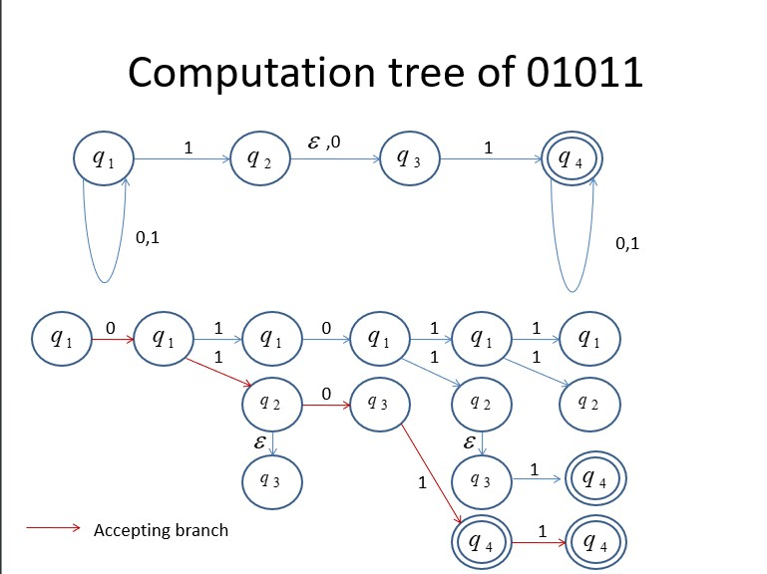

Slide 26
Computations of NFAs
In general, a computation of an NFA N, on input w, induces a computation tree.
Each path of the computation tree represents a possible computation of N.
The NFA N accepts w, iff its computation tree includes at least one path ending with an accepting state.

Slide 27
Why NFAs?
NFA-s and DFA-s are equivalent (Meaning: They recognize the same set of languages). In other words: Each NFA (recognizing language L) has an equivalent DFA (recognizing L).
(Note: This statement can be proven.)
But usually, the NFA is simpler.
Enables the proof of some theorems. (eg. about regular operations)

Slide 28
Example - A Complicated DFA
Can you describe the language? ∑*1 ∑ ∑
0
1
1
1
1
0
0
1
1
0
0
0
1
1
0
0

Slide 29
Example – An NFA
Can you describe this language?
It accepts any words that ends with 1∑∑
NP = Nondeterministic Polynomial:
try multiple paths simultaneously
Always guess right
Solution can be verified in P time
0,1
1
0,1
0,1

Slide 30
DFA Definition Revisited
A finite automaton is a 5-tuple where:
is a finite set called the states.
is a finite set called the alphabet.
is the transition function.
is the start state, and
is the set of accepting states.

Slide 31
NFA – A Formal Definition
A N finite automaton is a 5-tuple where:
is a finite set called the states.
is a finite set called the alphabet.
is the transition function. ( )
is the start state, and
is the set of accept states

Slide 32
Differences between NFA-s and DFA-s
There are two differences:
The range of the transition function is now P(Q) .
(P(Q) is set of all subsets of the state set )
2. The transition function allows transitions.
Q= {1,2,3} → |Q| = 3
P(Q) ={{}, {1}, {2}, {3}, {1,2}, {1,3}, {2,3}, {1,2,3} }
|p(Q)| = 2^3 = 8

Slide 33
Computations of NFAs
There are two ways to look at computations of an NFA:
The first is to say that the NFA N always “chooses” the right path on its tree of possible computations.
The second is to say that the NFA N traverses its computation tree “in parallel”.
The same nondeterminism as in NP-complete!

Slide 34
Equivalence Between DFAs and NFAs
Now we prove that the class of NFAs is Equivalent to the class of DFA:
Theorem: For every NFA N, there exists a DFA , such that .
Proof Idea: The proof is Constructive: We assume that we know , and construct a simulating DFA . How?

Slide 35
Construction Demonstration
We start with an NFA with no transitions.
The equivalent DFA is denoted by:
How does a DFA represents/models the fact that each transition in NFA can leads to MANY states?
1
0
0,1
0,1

Slide 36
Construction Demonstration
The state set of the equivalent DFA D, should reflect the fact that at each step of the computation, N may occupy several sates, Thus we define the state set of D to correspond to P(Q) of N, i.e., one for each subset, EX,

Slide 37
Construction Demonstration
Recall that the transition function of any NFA is defined by .
D is a DFA, not the original NFA. As such, its transition function δ: Qx∑ → Q’
Q’ is not a power-set, but rather a big yet simple set which has as many states as P(Q) .

Slide 38
Construction Demonstration
The alphabet of D, , is identical to the alphabet of N.
The starting state of D corresponds to the starting state of N, ex., .
The most complex part of the construction is the transition function.
We first illustrate with our example.

Slide 39
Construction Demonstration
1
0
Since the only state reachable from by 0 is ,
we get .
0,1
0,1
0

Slide 40
Construction Demonstration
1
0
Since both and are reachable from by 1,
we get .
0,1
0,1
1
0

Slide 41
Construction Demonstration
1
0
Similarly we get .
0,1
0,1
1
0
1

Slide 42
Construction Demonstration
1
0
and .
0,1
0,1
1
0
0
1

Slide 43
Construction Demonstration
1
0
Since and , we get .
0,1
0,1
1
0
1
0
1
0

Slide 44
Construction Demonstration
1
0
Finally we get the following DFA:
0,1
0,1
0
1
0
1
1
0
1
0

Slide 45
Construction Demonstration
0
1
0
1
1
0
1
0

Slide 46
Construction Demonstration
1
0
{Q1, Q3} is an accepting state since q3 was an accepting state in the original NFA.
0,1
0,1
0
1
0
1
1
0
1
0

Slide 47
Construction Demonstration
1
0
The state q1q2q3 is an accepting state since q3 was an accepting state in the original NFA.
0,1
0,1
0
1
0
1
1
0
1
0

Slide 48
Equivalence Between DFAs and NFAs
Every DFA is (A special case of) an NFA, hence , but .
Nevertheless, these classes are Equivalent.
This means that for any NFA N there exists a DFA D satisfying: .

Slide 49
Equivalence Between DFAs and NFAs
Thus, to prove equivalence of the classes we prove:
Theorem: For every NFA N there exists a DFA D satisfying :
Proof Idea: The proof is Constructive: We assume that we know , and construct a simulating DFA, D .

Slide 50
Proof
Let recognizing some language A. The state set of the simulating DFA D, should reflect the fact that at each step of the computation, N may occupy several sates.
Thus we define the state set of D as the power-set of the state set of N.

Slide 51
Proof (cont.)
Let recognizing some language A. First we assume that N has no - transitions.
Define where .

Slide 52
Proof (cont.)
Our next task is to define D’s transition function, : For any and define
If R is a state of M, then it is a set of states of N. When M in state R processes an input symbol a, M goes to the set of states to which N will go in any of the branches of its computation.

Slide 53
Proof (cont.)
An alternative way to write the definition of M’s transition function, is: For any and define
And the explanation is just the same.
Note: if than
Which is OK since .

Slide 54
Proof (cont.)
The initial state of D is: .
Finally, the final state of D is:
Since D accepts if N reaches at least one accepting state.
The reader can verify for her/him self that D indeed simulates N .

Slide 55
Proof (cont.)
We still have to consider - transitions.
For any state of D define (closure of R) to be the collection of states of R unified with the states reachable from R by - transitions. The old definition of is:
And the new definition is:

Slide 56
Proof (end)
In addition, we have to change the definition of , the initial state of . The previous definition, , is replaced with .
Once again the reader can verify that the new definition of D satisfies all requirements.

Slide 57
Corollary
A language L is regular iff there exists an NFA recognizing L .
(return to PLP2 Regex)

Slide 58
Regular Expression (Regex) & FA
Regular languages are defined and described by use of finite automata.
Regular Expressions is an equivalent, yet more elegant way, to describe regular languages.
Regex is also easier for computer programs (such as scanner generator, compiler compiler, ex., yacc = yet another compiler compiler, antlr) to understand.

Slide 59
Motivation for Regex
If one wants to describe a regular language, La, one can use the a DFA, D (or an NFA N), such that that .
This is not always very convenient.
Consider for example the regular expression describing the language of binary strings containing a single 1.

Slide 60
Basic Regular Expressions
A Regular Expression is a string of symbols that describes a regular Language.
Let be an alphabet. For each , the symbol is an Regex representing the set
The symbol is an Regex representing the set
. (The set containing the empty string).
The symbol is an Regex representing the empty set.

Slide 61
Regular Operators
Let and be 2 regular languages from the same alphabet, . We define the 3 Regular Operations:
Union: .
Concatenation: .
Star: .

Slide 62
The Regular Operations - Examples
.

Slide 63
Elaboration
Union is straight forward.
Concatenation is the operation in which a word in A is followed with a word in B.
Star is a unary operation in which each word in A is concatenated with every other word in A and this happens 0 or more times.

Slide 64
The Power of Nondeterminism
We showed operators are closed in RL using FA.
Specifically, given two NFAs for two regex, how do we construct a NFA recognizing union, concatenation, star of the original regex
This can be done relatively easily by using NFAs.

Slide 65
Theorem
The class of Regular languages is closed under the all three regular operations.
Why is this useful? We can use these 3 operators to build complex regex from more basic, simpler ones

Slide 66
Proof for union Using NFAs
If and are regular, each has its own recognizing automaton and , respectively.
In order to prove that the language is regular, all we have to do is to construct a new FA that accepts exactly the words in .

Slide 67
A Pictorial proof
F

Slide 68
Proof for union Using NFAs
Let recognizing A₁ , and recognizing A₂ .
Construct to recognize ,
Where , ,

Slide 69
Theorem
The class of Regular languages is closed under the concatenation operation.

Slide 70
Proof idea
Given an input word to be checked whether it belongs to , we may want to run until it reaches an accepting state and then to move to .

Slide 71
Proof idea
The problem: Whenever an accepting state in N1 is reached, we cannot be sure whether the word of is finished yet.
The idea: Use non-determinism to choose the right point in which the word of is finished and the word of starts.

Slide 72
A Pictorial proof
F

Slide 73
Proof using NFAs
Let recognizing A₁ , and recognizing A₂ .
Construct to recognize ,
Where , ,

Slide 74
Theorem
The class of Regular languages is closed under the star operation.

Slide 75
A Pictorial proof
F

Slide 76
Proof using NFAs
Let recognizing A₁ .
Construct to recognize
Where , , and

Slide 77
Inductive Construction
Let and be two regular expressions representing languages and , resp.
The string is a regular expression representing the set .
The string is a regular expression representing the set .
The string is a regular expression representing the set .

Slide 78
Inductive Construction - Remarks
This inductive definition also dictates the way we will prove theorems: For any theorem T.
Stage 1: Prove T correct for all base cases.
Stage 2: Assume T is correct for and . Prove correctness for , , and .

Slide 79
Some Useful Notation
Let be a regular expression:
The string represents , and it also holds that .
The string represents .
The string represents any one symbol from the alphabet
The Language represented by R is denoted by .

Slide 80
Precedence Rules
The star (*) operation has the highest precedence.
The concatenation ( ) operation is second on the preference order.
The union ( ) operation has the lowest precedence, ex., (AUB)C vs AUBC

Slide 81
Examples – write Regex for each of the following languages {w|w….}
w has exactly a single 1 (ex., 0010): 0*10*
w has at least one 1 (ex., 01010): (0|1)*1(0|1)*
w contains the substring 101: ∑* 101 ∑*
Every 0 in w is followed by one or more 1s: 1*(01⁺⁾
W is of even length: (∑ ∑)*
W starts and ends with the same letter:
W has the forms 1,1,…,1 or 0,1,1,…1:

Slide 82
Examples
– .
– .
– .
– .
– .
∑(∑∑)* – w is of odd length

Slide 83
Examples
- all words starting and ending with the same letter.
- all strings of forms 1,1,…,1 and 0,1,1,…1 .
- A set concatenated with the empty set yields the empty set .
- .

Slide 84
Equivalence With Finite Automata
Regular expressions and finite automata are equivalent in their descriptive power. This fact is expressed in the following Theorem:
Theorem A set is regular if and only if it can be described by a regular expression.
The proof is by two Lemmas:

Slide 85
Lemma ->
Regex → re L (i.e., L can be described by a FA)
If a language L can be described by regular expression then L is regular.

Slide 86
Proofs Using Inductive Definition
The proof follows the inductive definition of RE-s as follows:
Stage 1: Prove correctness for all base cases.
Stage 2: Assume correctness for and , and show its correctness for , and .

Slide 87
Induction Basis
For any , the expression describes the set , recognized by:
The set represented by the expression is recognized by:
The set represented by the expression is recognized by:

Slide 88
The Induction Step
Now, we assume that and represent two regular sets and claim that , and represent the corresponding regular sets.
The proof for this claim is straight forward using the constructions given in the proof for the closure of the three regular operations.

Slide 89
Examples – try it yourself
Show that the following regular expressions represent regular languages (pick one):
.
.
Note: these are examples used to illustrate the proof process, NOT actual proof.
To be demonstrated on the board.

Slide 90
Lemma <-
If a language L is regular then L can be described by some regular expression.
L is regular = there is a FA → there is a regex

Slide 91
Proof Stages
The proof follows the following stages:
Define Generalized Nondeterministic Finite Automaton (GNFA in short).
Show how to convert any DFA to an equivalent GNFA.
Show an algorithm to convert any GNFA to an equivalent GNFA with 2 states.
Convert a 2-state GNFA to an equivalent Regex.

Slide 92
Properties of a Generalized NFA
A GNFA is a finite automaton in which each transition is labeled with a regular expression over the alphabet .
A single initial state with all possible outgoing transitions and no incoming trans.
A single Accept state without outgoing trans.
A single transition between every two states, including self loops.
,

Slide 93
Example of a Generalized NFA

Slide 94
A Computation of a GNFA
A computation of a GNFA is similar to a computation of an NFA. except: In each step, a GNFA consumes a block of symbols that matches the RE on the transition used by the NFA.

Slide 95
Example of a GNFA Computation
Consider abbbaaabb

Slide 96
Converting a DFA (or NFA) to a GNFA
Conversion is done by a very simple process:
Add a new start state with an - transition from the new start state to the old start state.
Add a new accepting state with - transition from every old accepting state(s) to the new accepting state.

Slide 97
Converting a DFA to a GNFA (Cont)
3. Replace any transition with multiple labels by a single transition labeled with the union of all labels.
Add any missing transition, including self transitions; label the added transition by .

Slide 98
Stage 1: Convert D to a GNFA
1.0 Start with D

Slide 99
Stage 1: Convert D to a GNFA
1.1 Add 2 new states

Slide 100
Stage 1: Convert D to a GNFA
1.2 Make the initial state and the final state.

Slide 101
Stage 1: Convert D to a GNFA
1.3 Replace multi label transitions by their union.

Slide 102
Stage 1: Convert D to a GNFA
1.4 Add all missing transitions and label them .

Slide 103
Ripping a state from a GNFA
The final element needed for the proof is a procedure in which for any GFN G, any state of G, not including and , can be ripped off G, while preserving . This is demonstrated in the next slide by considering a general state, denoted by , and an arbitrary pair of states, and , as demonstrated in the next slide:

Slide 104
Removing a state from a GNFA
Before Ripping
After Ripping
Note: This should be done for every pair of states going through .

Slide 105
Ellaboration
Consider Regex , representing all strings that enable transition from via to .
What we want to do is to augment the Regular expression of transition , namely , so These strings can pass through . This is done by setting it to .

Slide 106
Ellaboration
Note: In order to achieve an equivalent GNFA in which is disconnected, this procedure should be carried out separately, for every pair of transitions of the form and . Then can be removed, as demonstrated on the next slide:

Slide 107
Elaboration
Assume the following situation: In order to rip , all pairs of incoming and outgoing transitions should be considered in the way showed on the previous slide namely consider one after the other. After that can be ripped while preserving .

Slide 108
q_{i} and q_{j} can be the same state
Replace with .

Slide 109
GNFA – A Formal Definition
A Generalized Finite Automaton is a 5-tupple where:
is a finite set called the states.
is a finite set called the alphabet.
* is the transition function.
is the start state, and
is the accept state.

Slide 110
GNFA – Defining a Computation
A GNFA accepts a string if and there exists a sequence of states , satisfying:
For each , , , where , or in other words, is the expression on the arrow from to .

Slide 111
Procedure CONVERT
Procedure CONVERT takes as input a GNFA G with k states, and produce a regex.
If then these 2 states must be and , and the algorithm returns
.
If , the algorithm converts G to an equivalent G’ with states by use of the ripping procedure described before.

Slide 112
Procedure CONVERT
Convert
;
If return ;
;
;
For any and any
for return ;

Slide 113
Pumping Lemma - Motivation
Are all languages regular? nope
Because there are words that RL can not describe., ex palindrome: racecar
Another Simple example is the language
Contrast with

Slide 114
Introduction and Motivation
If we try to find a DFA that recognizes the language , , it seems that we need an infinite number of states, to “remember” how many a-s we’ve seen so far.
Note: This is not a proof!
Perhaps a DFA recognizing B exists, but we are not clever enough to find it?

Slide 115
Introduction and Motivation
The Pumping Lemma is the formal tool we use to prove that the language B (as well as many other languages) is not regular.

Slide 116
What is Pumping?
Consider the following NFA, denoted by N:
It accepts all words of the form .

Slide 117
What is Pumping?
Consider now the word .
Pumping means that the word can be divided into two parts: 1 and 01, such that for any , the word .
We say that the word 101 can be pumped.
For this is called down pumping.
For this is called up pumping.

Slide 118
What is Pumping?
A more general description would be: A word , can be pumped if and for each , it holds that .
Note: the formal definition is a little more complex than this one.

Slide 119
The Pumping Lemma
Let A be a regular language. There exists a number p such that for every , if then w may be divided into three parts , satisfying:
for each , it holds that .
.
.
Note: Without req. 2 the Theorem is trivial.

Slide 120
Demonstration Continuation
In terms of the previous demonstration we have:
.
For , we get:
. . .

Slide 121
Proof of the Pumping Lemma
Let D be a DFA recognizing A and let p be the number of states of D.
If A has no words whose length is at least p, the theorem holds trivially.
Let be an arbitrary word such that .Denote the symbols of w by where .

Slide 122
Proof of the Pumping Lemma
Assume that is the sequence of states that D goes through while computing with input w. For each , , . Since , .
Since the sequence contains states and since the number of states of D is p, that there exist two indices , such that (can you figure out the y?)

Slide 123
Proof of the Pumping Lemma
Denote , and .
Note: Under this definition and .
By this definition, the computation of D on starting from , ends at .
By this definition, the computation of D on , starting from , ends at which is an accepting state.

Slide 124
Proof of the Pumping Lemma
The computation of D on starting from , ends at . Since , this computation starts and ends at the same state.
Since it is a circular computation, it can repeat itself k times for any .
In other words: for each , .
Q.E.D.

Slide 125
Proof Example:
Lemma: The language is not regular.
Proof: Assume towards a contradiction that L is regular and let p be the pumping length of L.
Let . By the Pumping Lemma there exists a division of w, , such that , and w can be pumped, with y,
where , i.e., is in L.

Slide 126
Example:
Consider what y may contain:
y = a^{k} → a^{p-k} (a^{k} )⁵ b^{p} , i.e., more a-s than b-s
y = b^{k}
y = a^{k}b^{k} → a^{p-k} (a^{k} b^{k} )⁵ b^{p-k}
What does xy^{i}z look like?
Too many a-s with i>0
Too many b-s with i>0
There will be b-s before a-s, not the correct format

Slide 127
Discussion
This is what we got so far:
RL-s Ex:

